Slide 1
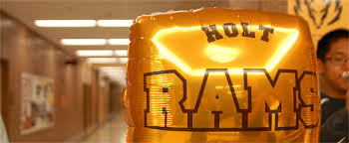
Holt Science Olympiad division b Invitational
February 20, 2016

Slide 2
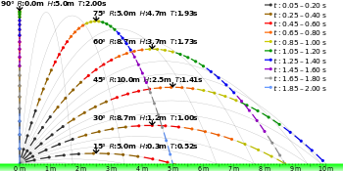
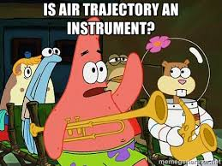
Air Trajectory
1st Place – Holt Jr. HS Gold
2nd Place – Meads Mill MS
3rd Place – Washtenaw Int’l Academy MS
4th Place – Scranton MS
5th Place – L’Anse Creuse Blue
6th Place – Canton Charter Academy Red

Slide 3
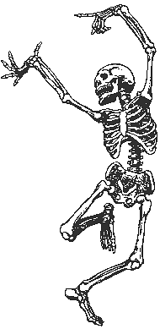
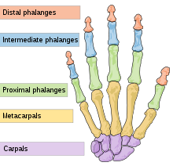
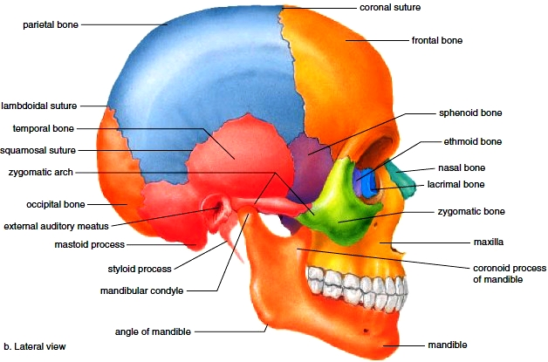
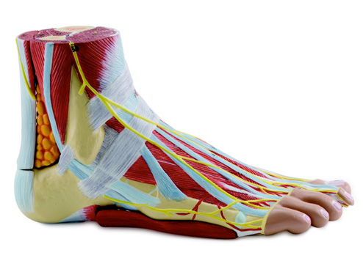
Anatomy & Physiology
1st Place – Canton Charter Acad White
2nd Place – Meads Mill MS
3rd Place – Holt Jr. HS Gold
4th Place – Canton Charter Acad Red
5th Place – Washtenaw Int’l MS Acad
6th Place – L’Anse Creuse Blue

Slide 4
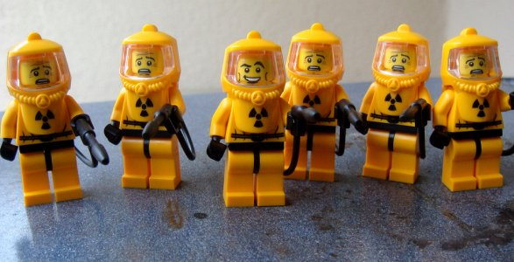
Bio-Process Lab
1st Place – L’Anse Creuse Gold
2nd Place – Meads Mill MS
3rd Place – Fowlerville Jr. HS
4th Place – Canton Charter Academy White
5th Place – Kinawa MS Delta
6th Place – Canton Charter Academy Red

Slide 5
Bottle Rocket
1st Place – Canton Charter Academy Red
2nd Place – Scranton MS
3rd Place – Canton Charter Academy White
4th Place – Meads Mill MS
5th Place – L’Anse Creuse Blue
6th Place – L’Anse Creuse Gold

Slide 6
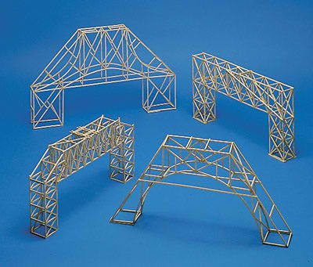
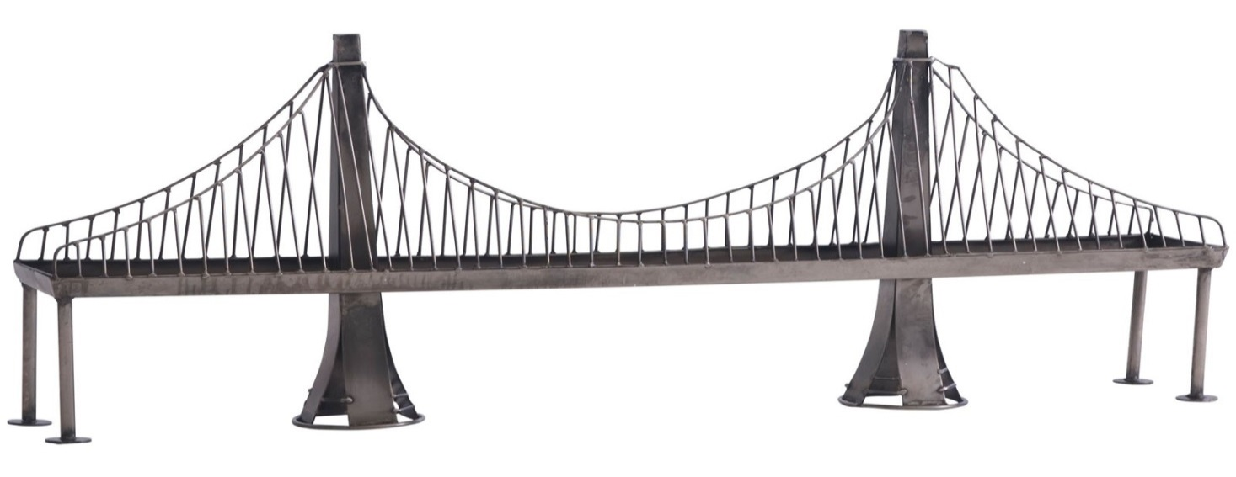
Bridge Building
1st Place – Meads Mill MS
2nd Place – Scranton MS
3rd Place – Washington Woods MS
4th Place – Washtenaw Int’l MS Academy
5th Place – Holt Jr. HS Brown
6th Place – St. Martha

Slide 7
Crave The Wave
1st Place – Canton Charter Academy White
2nd Place – Meads Mill MS
3rd Place – L’Anse Creuse Gold
4th Place – Holt Jr. HS Gold
5th Place – Canton Charter Academy Red
6th Place – Fowlerville Jr. HS

Slide 8
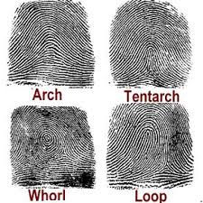
Crime Busters
1st Place – Meads Mill MS
2nd Place – L’Anse Creuse Blue
3rd Place – Canton Charter Academy Red
4th Place – Holt Jr. HS Gold
5th Place – Holt Jr. HS Brown
6th Place – Chippewa MS Blue

Slide 9
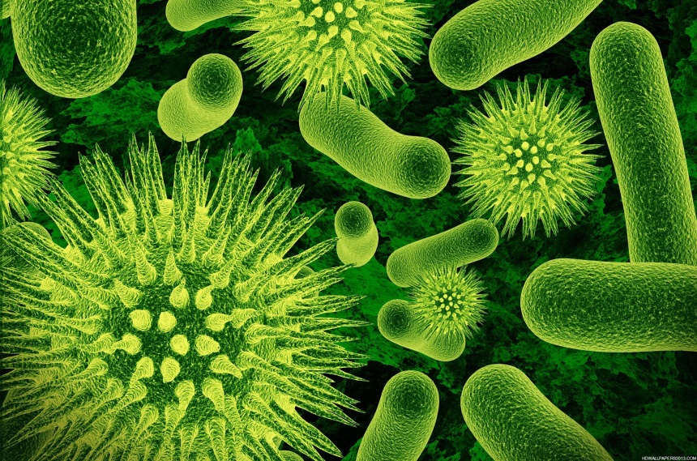
Disease Detectives
1st Place – Meads Mill MS
2nd Place – L’Anse Creuse Gold
3rd Place – Chippewa MS Blue
4th Place – Canton Charter Academy Red
5th Place – Holt Jr. HS Brown
6th Place – Kinawa MS Omega

Slide 10
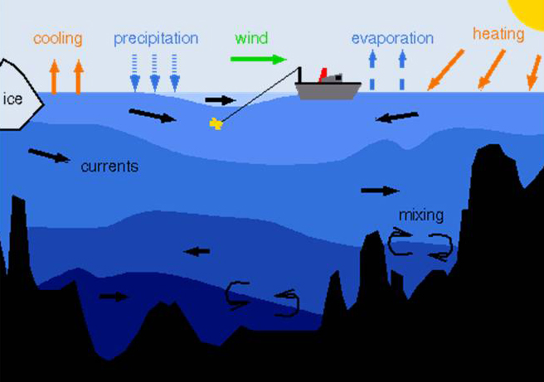
Dynamic Planet
1st Place – L’Anse Creuse Blue
2nd Place – Canton Charter Academy White
3rd Place – Canton Charter Academy Red
4th Place – L’Anse Creuse Gold
5th Place – Fowlerville Jr. HS
6th Place – Scranton MS

Slide 11
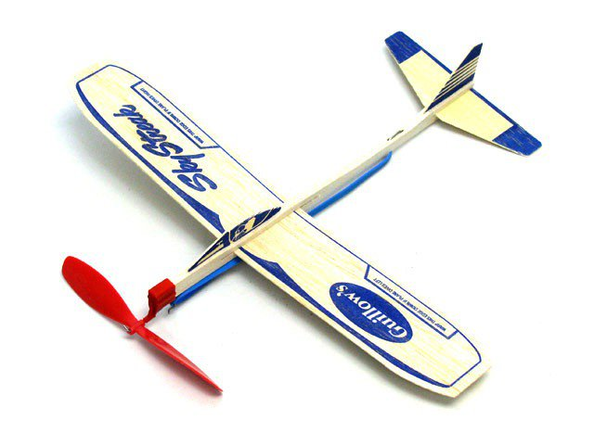
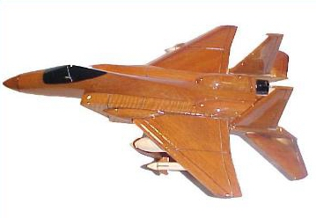
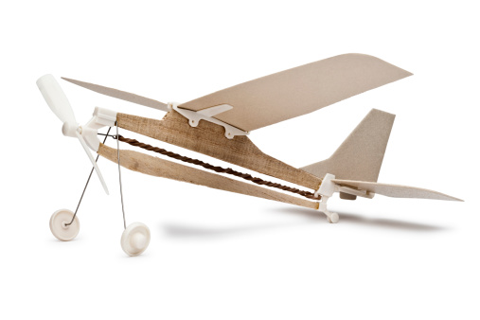
Elastic Launched Glider
1st Place – Scranton MS
2nd Place – Meads Mill MS
3rd Place – L’Anse Creuse Gold
4th Place – L’Anse Creuse Blue
5th Place – Canton Charter Academy Red
6th Place – Holt Jr. HS Gold

Slide 12
Experimental Design
1st Place – Meads Mill MS
2nd Place – Holt Jr. HS Brown
3rd Place – Scranton MS
4th Place – Holt Jr. HS Gold
5th Place – Chippewa MS Maroon
6th Place – Fowlerville Jr. HS

Slide 13
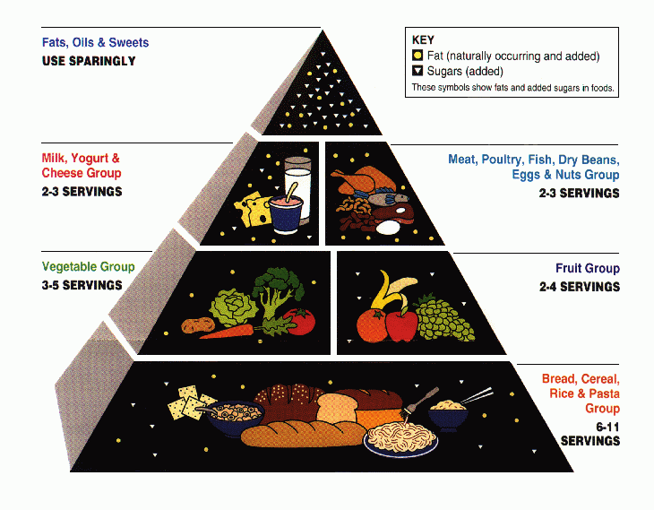
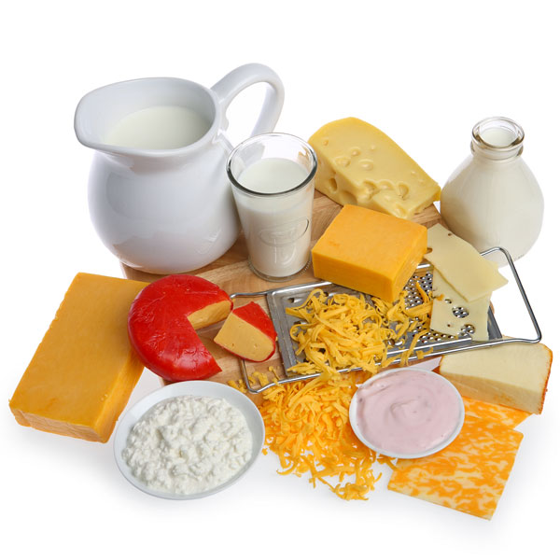
Food Science
1st Place – Holt Jr. HS Gold
2nd Place – Meads Mill MS
3rd Place – Canton Charter Academy White
4th Place – St. Martha
5th Place – Scranton MS
6th Place – Canton Charter Academy Red

Slide 14
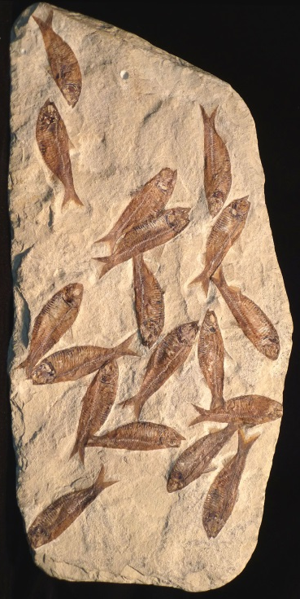
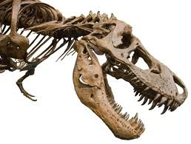
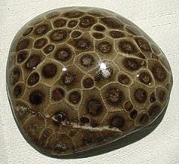
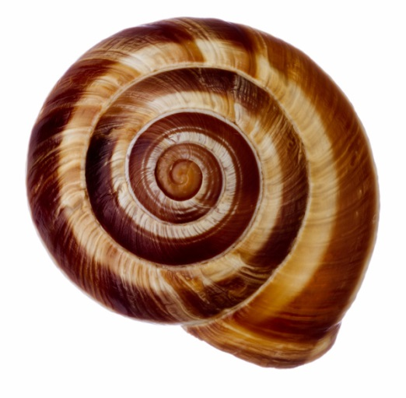
Fossils
1st Place – Meads Mill MS
2nd Place – Washtenaw Int’l MS Academy
3rd Place – Scranton MS
4th Place – Canton Charter Academy White
5th Place – L’Anse Creuse Blue
6th Place – Holt Jr. HS Brown

Slide 15
Green Generation
1st Place – Scranton MS
2nd Place – Washtenaw Int’l MS Academy
3rd Place – L’Anse Creuse Gold
4th Place – Holt Jr. HS Gold
5th Place – Holt Jr. HS Brown
6th Place – Kinawa MS Omega

Slide 16
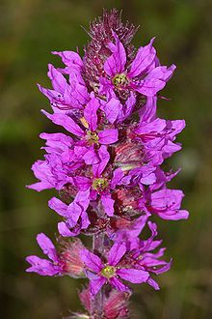
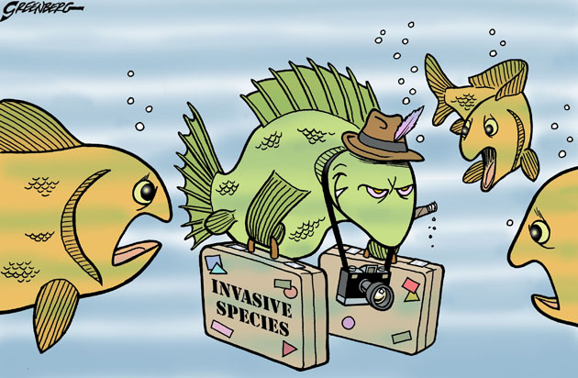
Invasive Species
1st Place – Meads Mill MS
2nd Place – L’Anse Creuse Gold
3rd Place – L’Anse Creuse Blue
4th Place – Holt Jr. HS Gold
5th Place – Scranton MS
6th Place – Fowlerville Jr. HS

Slide 17
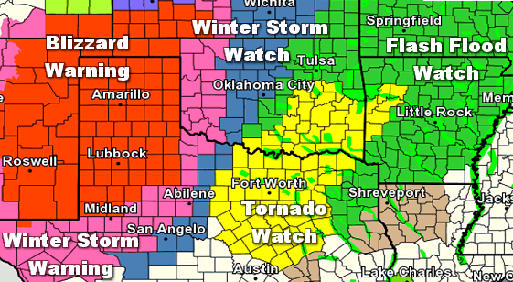
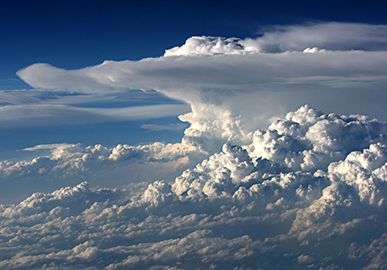
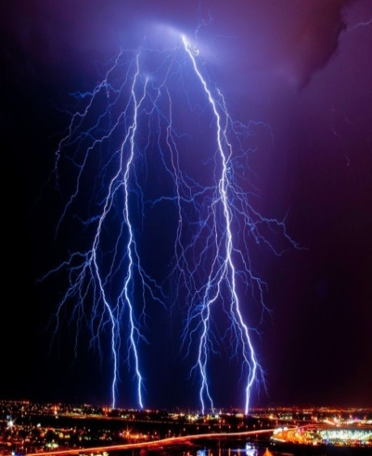
Meteorology
1st Place – Meads Mill MS
2nd Place – Canton Charter Academy White
3rd Place – Fowlerville Jr. HS
4th Place – Chippewa MS Maroon
5th Place – Hope MS
6th Place – Washington Woods MS

Slide 18
Mission Possible
1st Place – Meads Mill MS
2nd Place – Scranton MS
3rd Place – Canton Charter Academy Red
4th Place – Chippewa MS Maroon
5th Place – Canton Charter Academy White
6th Place – Washtenaw Int’l MS Academy

Slide 19
Picture This
1st Place – Chippewa MS Maroon
2nd Place – L’Anse Creuse Blue
3rd Place – Canton Charter Academy Red
4th Place – L’Anse Creuse Gold
5th Place – Scranton MS
6th Place – Holt Jr. HS Brown

Slide 20
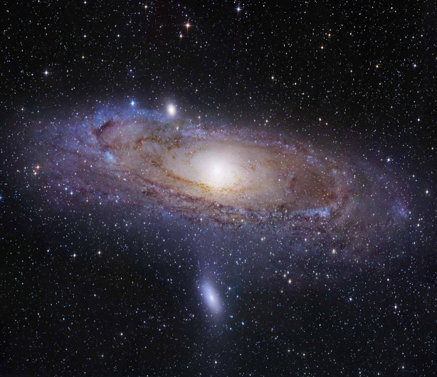
Reach For The Stars
1st Place – Canton Charter Academy Red
2nd Place – Meads Mill MS
3rd Place – Canton Charter Academy White
4th Place – L’Anse Creuse Gold
5th Place – L’Anse Creuse Blue
6th Place – Washtenaw Int’l MS Acad

Slide 21
Road Scholar
1st Place – Holt Jr. HS Gold
2nd Place – Canton Charter Academy White
3rd Place – Scranton MS
4th Place – Holt Jr. HS Brown
5th Place – L’Anse Creuse Gold
6th Place – Meads Mill MS

Slide 22
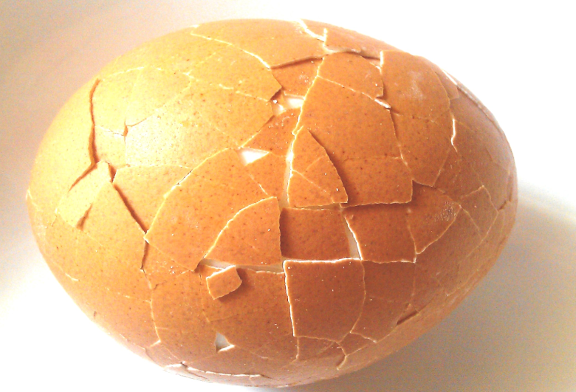
Scrambler
1st Place – Meads Mill MS
2nd Place – Washington Woods MS
3rd Place – Canton Charter Academy White
4th Place – Canton Charter Academy Red
5th Place – Holt Jr. HS Gold
6th Place – L’Anse Creuse Gold

Slide 23
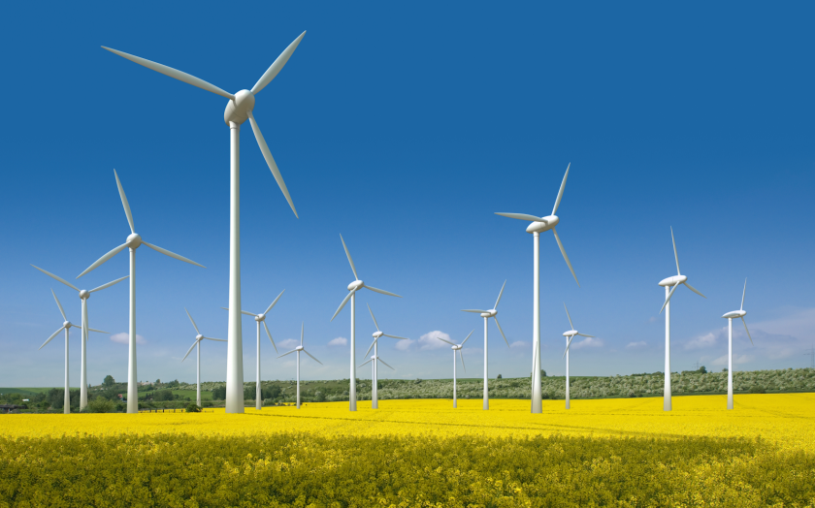
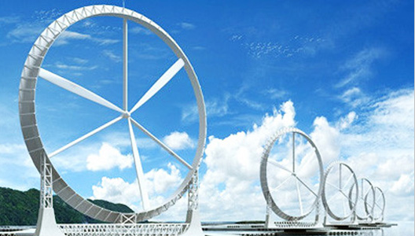
Wind Power
1st Place – Meads Mill MS
2nd Place – Canton Charter Academy White
3rd Place – L’Anse Creuse Gold
4th Place – Canton Charter Academy Red
5th Place – Holt Jr. HS Gold
6th Place – Scranton MS

Slide 24
Write It/Do It
1st Place – Meads Mill MS
2nd Place – Kinawa MS Omega
3rd Place – Chippewa MS Blue
4th Place – Holt Jr. HS Gold
5th Place – L’Anse Creuse Blue
6th Place – Chippewa MS Maroon

Slide 25
6th Place
Washtenaw International Middle School Academy
L’Anse Creuse Blue would have been awarded 6th place, however L’Anse Creuse Gold was awarded a higher place

Slide 26
5th Place
L’Anse Creuse Gold
(Also L’Anse Creuse Blue)
Canton Charter Academy Red would have been awarded 5th place, however Canton Charter Academy White was awarded a higher place.

Slide 27
4th Place
Holt Junior High School Gold

Slide 28
3rd Place
Scranton Middle School

Slide 29
2nd Place
Canton Charter Academy White
(Also Canton Charter Academy Red)

Slide 30
1st Place
Meads Mill Middle School

