Slide 1
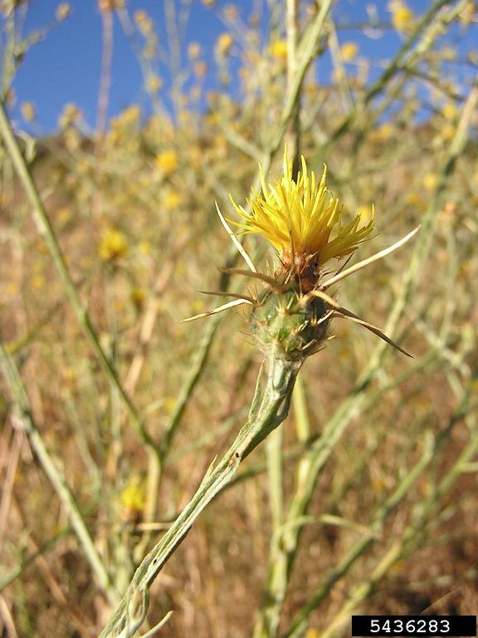
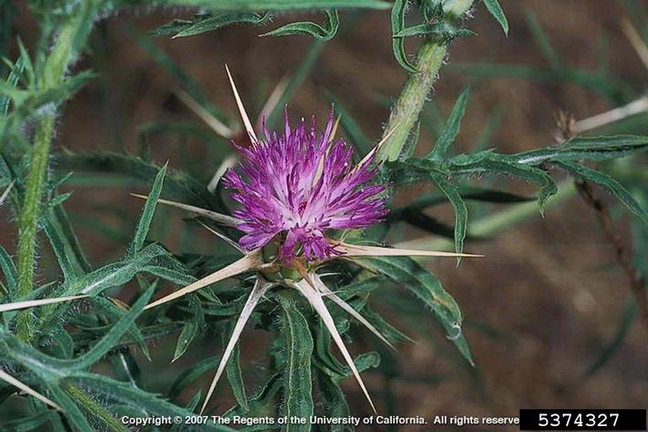
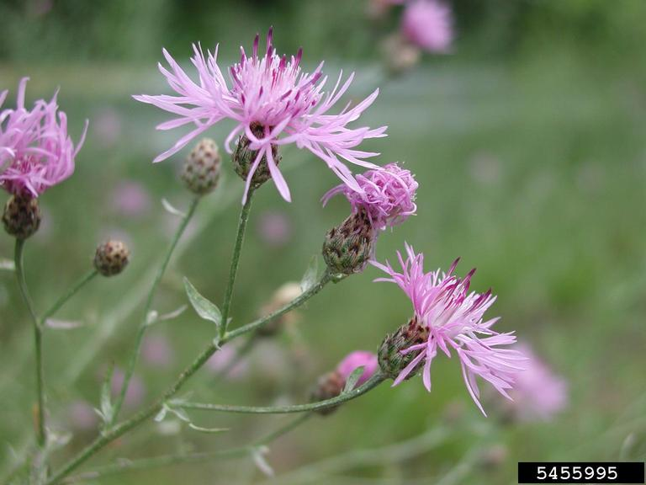
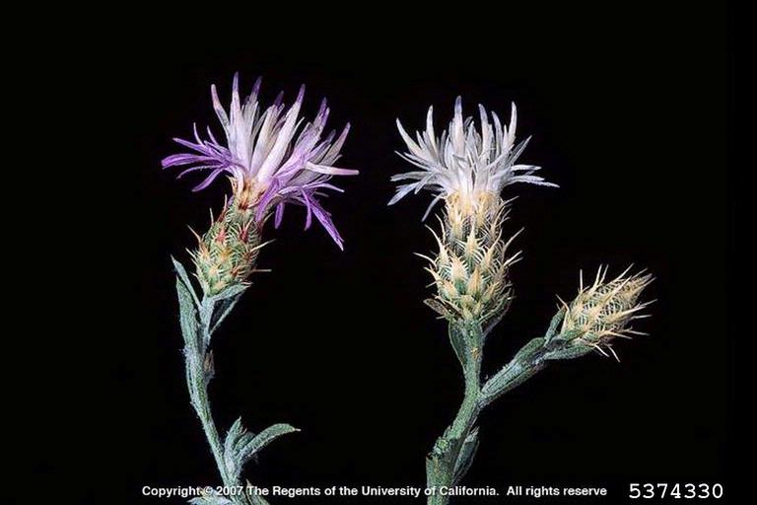
STATION D. Identify the invasive plant species
2.
1.
3.
4.

Slide 2
STATION E. Match the invasive species with its effect
Bythotrephes
Lissachatina
3. Anoplophora
4. Alliaria
5. Lythrum
6. Pseudogymnoascus
Weakens and kills temperate hardwoods
B. Shades out native species
C. Crowds out native wetland species
D. Clogs fishing lines
E. Causes extensive damage to plants in tropical and subtropical agricultural systems
F. Causes decline in bat populations

Slide 3
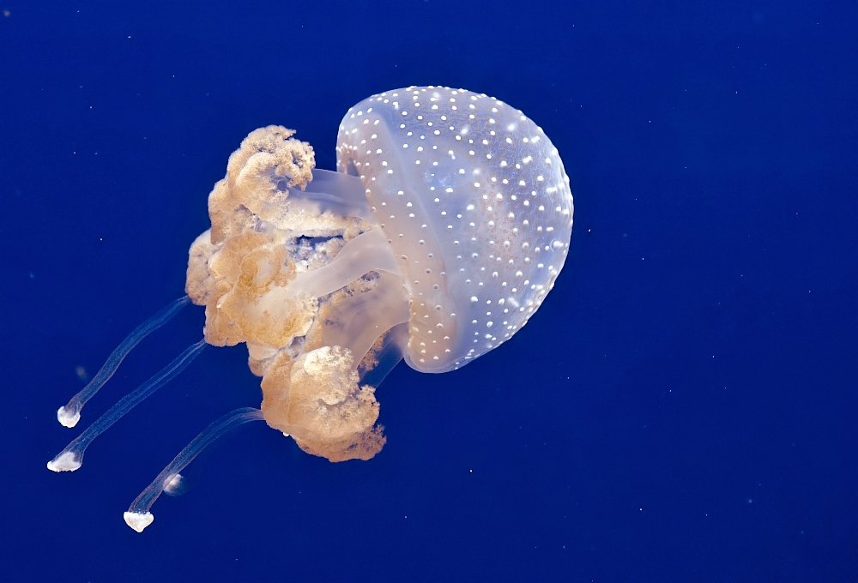
STATION F.
Photo © Orest Shvadchak, 2011

Slide 4
STATION F. Answer the following questions
Identify the common and scientific name of the species.
2. Place in order the stages of this species’ life cycle, starting with the egg. (5 pt)
Medusa Egg Planula Polyp Blastula
3. True or false: The sting of this species is extremely painful, producing blisters and peeling skin, and is occasionally responsible for the death of small animals and children.
4. How does significantly lower salinities (lower than ocean’s average level) affect this species?
5. True or false: This species positively impacts shrimp industry by clogging nets and damaging fishing equipment.
6. Select the correct answer: This species was first discovered in which U.S. state
Florida b) Hawaii c) California d) Alaska

Slide 5
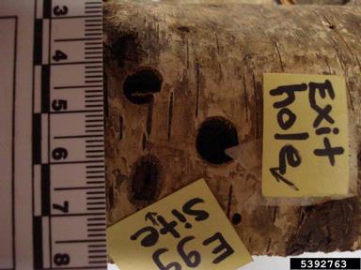
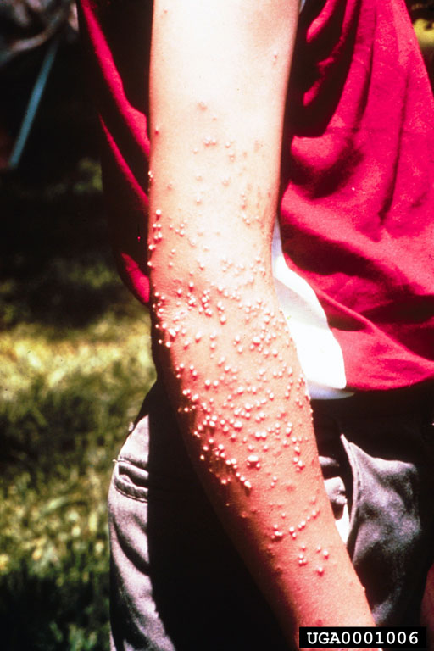
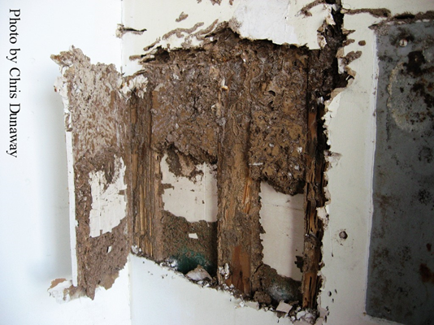
STATION G. Name the insect responsible for the damage below
3.
1.
2.
4.
5.

Slide 6
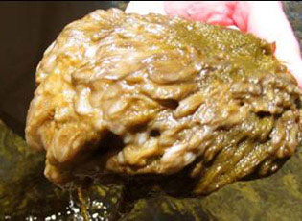
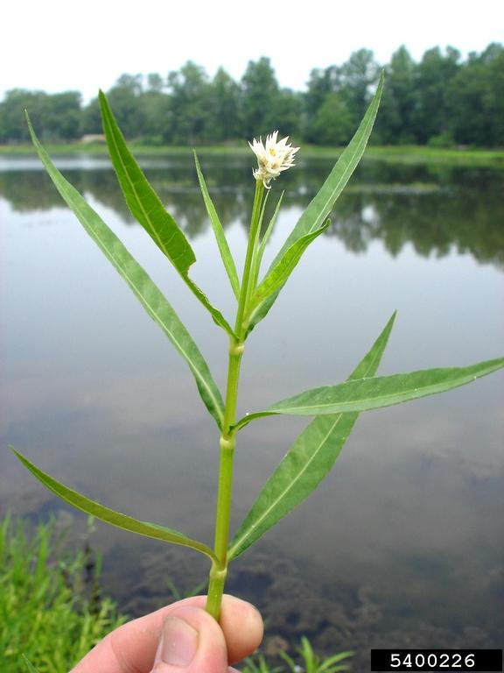
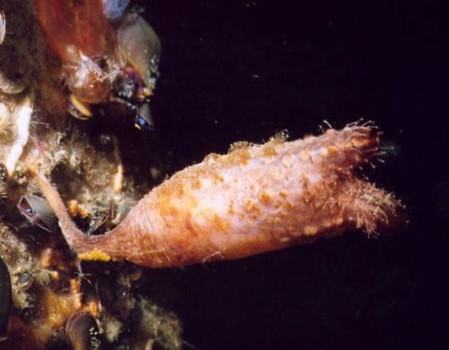
STATION H. Identify the invasive species by the scientific name.
1.
3.
2.
Continue to next slide ➔

Slide 7
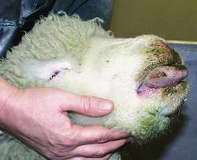
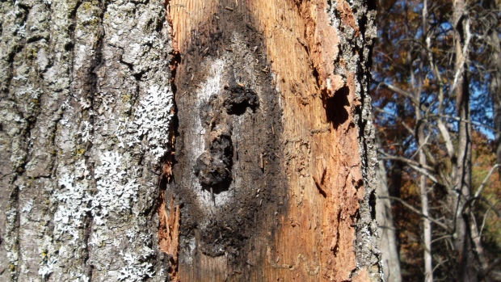
STATION H continued.
4.
5.

Slide 8
End
Thanks for competing and hand your answer
sheet to me.
Good luck on the rest of the day!

